Slide 1

Administration of the Liquor Act, Act 6 of 1998
Josef Mwapopi Shikongo
14 April 2023, Tsumeb
REPUBLIC OF NAMIBIA
MINISTRY OF INDUSTRIALISATION AND TRADE

Slide 2
OUTLINE
INTRODUCTION
OBJECTIVES
KIND AND TYPE OF LIQUOR LICENSE
LIQUOR TRADING HOURS
REGIONAL LIQUOR LICENSING COMMITTEE
APPLICATION REQUIREMENTS
CONSIDERATION OF LICENSE APPLICATIONS
APPEALS & PENALTIES
CHALLENGES
CONCLUSION

Slide 3
INTRODUCTION
Enacted on the 3 April 1998
Administered by the Ministry of Industrialisation and Trade in collaboration with the Ministry of Justice

Slide 4

OBJECTIVES
To control the sale and supply of liquor
To provide for matters incidental thereto

Slide 5
KIND AND TYPES OF LIQUOR LICENSES
OFF-SALES LICENSES | ON-CONSUMPTION LICENSES
Bottle store License | Hotel License
Grocery Liquor License | Restaurant License
Wholesale Liquor License | Shebeen Liquor License
Brewery Liquor License | Club Liquor License
Distillery License | Special Liquor License
Vineyard Liquor License | Temporary Liquor License
Parks Off-sales Liquor License | Vineyard on-consumption Liquor License
 | Parks on-consumption Liquor License

Slide 6
TRADING HOURS
KIND OF LICENCES |  | TIME OF BUSINESS & DAYS
DESCRIPTION OF THE LIQUOR LICENCE |  | MONDAY – FRIDAY | SATURDAY | SUNDAY | CLOSED DAY
Bottle store | May sell liquor | 08:00 to 19:00 | 08:00 to 13:00 | No trading | No trading
 | May deliver liquor | 09:00 to 20:00 | 09:00 to 15:00 | No trading | No trading
Grocery Liquor License |  | 08:00 to 19:00 | 08:00 to 13:00 | No trading | No trading
Wholesale Liquor Licence and Brewery Depot Liquor Licence |  | 07:00 to 18:00 | 08:00 to 13:00 | No trading | Sunday, Christmas Day, Good Friday, Ascension Day
Distillery Licence |  | 07:00 to 18:00 | 07:00 to 13:00 | No trading | No trading
Parks off-sales Liquor Licence |  | 08:00 to 18:00 | 07:00 to 13:00 | No trading | No trading
Vineyard Liquor Licence: in sealed container for removal from licensed premises |  | 08:00 to 19:00 | 08:00 to 13:00 | No trading | No trading
Vineyard Liquor Licence |  | 10:00 to 24:00 | Not Allowed | 12:00 to 14:30 and from 18:00 to 21:00 | No trading

Slide 7
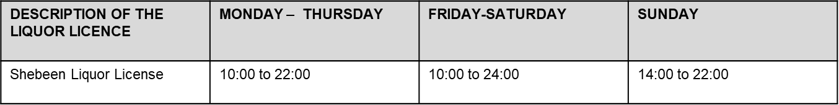
…continued
DESCRIPTION OF THE LIQUOR LICENCE | MONDAY – FRIDAY | SATURDAY | SUNDAY | CLOSED DAY
Hotel Liquor License | 10:00 to 24:00 | 10:00 to 24:00 | 10:00 to 14:30 and from 18:00 to 24:00
Restaurant Liquor License | 10:00 to 24:00 | 10:00 to 24:00 | 10:00 to 14:30 and from 18:00 to 24:00 | No Trading
Parks on-consumption Liquor License | 10:00 to 24:00 | 10:00 to 24:00 | 10:00 to 14:30 and from 18:00 to 24:00 | No Trading
Accommodation establishment rated one-star, two-star or three-star establishment | 10:00 to 02:00 the following day | 10:00 to 02:00 the following day | 10:00 to 02:00 the following day | 10:00 to 02:00 the following day
Accommodation establishment rated four-star, five-star establishment | Any time | Any time | Any time | Any time
Club Liquor License | 10:00 to 02:00 | 10:00 to 24:00 | 10:00 to 24:00 | Christmas Day, Good Friday, Ascension Day or Sunday

Slide 8
REGIONAL LIQUOR LICENSING COMMITTEE
Thirteen (13) Regional Liquor Licensing Committee
Composition of the RLLC:
  Two ex officio members:
    The Magistrate : chairperson
    Regional Commander of the Police or his or her Deputy
  Two members appointed by the Minister by notice in the Gazette
    A member can be
      Health Officer
      Social Worker registered / authorized to practice
      Registered Nurse
      Medical Practitioner
    A member nominated by the affiliated chamber in the Region
  A representative residing in the boundaries of the Region appointed by the Regional Council

Slide 9
REGIONAL LIQUOR LICENSING COMMITTEE
Twelve (12) meetings per annual
Every second Wednesday of the month
  NOTE: All the above meetings and application dates are in accordance with the Section 26 & 27 of the Liquor Act, Act No. 6 of 1998,
  Regulations 5 and 13 of the Liquor Regulations Government Notice 142 of 2001 as amended.
  Meeting venue is at the seat of the Region and ALL applications should be submitted with the Secretary of the Regional Liquor Licensing Committee.

Slide 10
Notable dates for 2023/2024
No. | Date of Meeting | SUBMISSION OF THE APPLICATIONS |  | ADVERTISEMENT DATE
 |  | From | To (Due Date) | From | To (Due Date)
1 | 11 Jan 2023 | 12 Nov 2022 | 30 Nov 2022 | 29 Oct 2023 | 5 Nov 2022
2 | 8 Feb 2023 | 10 Dec 2022 | 28 Dec 2022 | 26 Nov 2022 | 3 Dec 2022
3 | 8 Mar 2023 | 7 Jan 2023 | 25 Jan 2023 | 24 Dec 2022 | 31 Dec 2022
4 | 12 Apr 2023 | 11 Feb 2023 | 1 March 2023 | 28 Jan 2023 | 4 Feb 2023
5 | 10 May 2023 | 11 Mar 2023 | 29 Mar 2023 | 25 Feb 2023 | 4 Mar 2023
6 | 14 Jun 2023 | 15 Apr 2023 | 3 May 2023 | 1 Apr 2023 | 8 Apr 2023
7 | 12 July 2023 | 13 May 2023 | 31 May 2023 | 29 Apr 2023 | 6 May 2023
8 | 9 Aug 2023 | 10 Jun 2023 | 28 June 2023 | 27 May 2023 | 3 Jun 2023
9 | 13 Sep 2023 | 15 Jul 2023 | 2 Aug 2023 | 1 Jul 2023 | 8 Jul 2023
10 | 11 Oct 2023 | 12 Aug 2023 | 30 Aug 2023 | 29 Jul 2023 | 5 Aug 2023
11 | 8 Nov 2023 | 9 Sep 2023 | 27 Sep 2023 | 26 Aug 2023 | 2 Sep 2023
12 | 13 Dec 2023 | 14 Oct 2023 | 1 Nov 2023 | 30 Sep 2023 | 7 Oct2023
13 | 10 Jan 2024 | 11 November 2023 | 29 November 2023 | 28 Oct 2023 | 4 Nov 2023
14 | 14 Feb 2024 | 16 December 2023 | 3 January 2024 | 2 Dec 2023 | 9 Dec 2023

Slide 11
APPLICATION REQUIREMENTS
Plan of the premises
Description of the premises
Affidavit of financial interest
Certified copy of title deed/ lease agreement
Fitness certificate from Local Authority
Receipt (Application fee)
Copies of notice

Slide 12
CONSIDERATION OF LICENSE APPLICATION
FACTORS TAKEN INTO ACCOUNT WHEN CONSIDERING AN APPLICATION:
Social and Welfare consequences
Social unrest/public nuisance
Location(not in the vicinity of schools or a place of worship)
Town planning requirements ( Sanitary facilities in place to ensure health and safety of the consumers)
Monopolistic conditions
Name of business (not offensive to its community)

Slide 13
APPEALS
Appeal to the Chief Magistrate against such a decision with 14 days after such a decision was taken
Notice of appeal must be lodged in the prescribed form against payment of the fees

Slide 14
PENALTIES
A fine not exceeding N$ 4000-00 or imprisonment for a period not exceeding one (1) year or to both such fine and such imprisonment

Slide 15
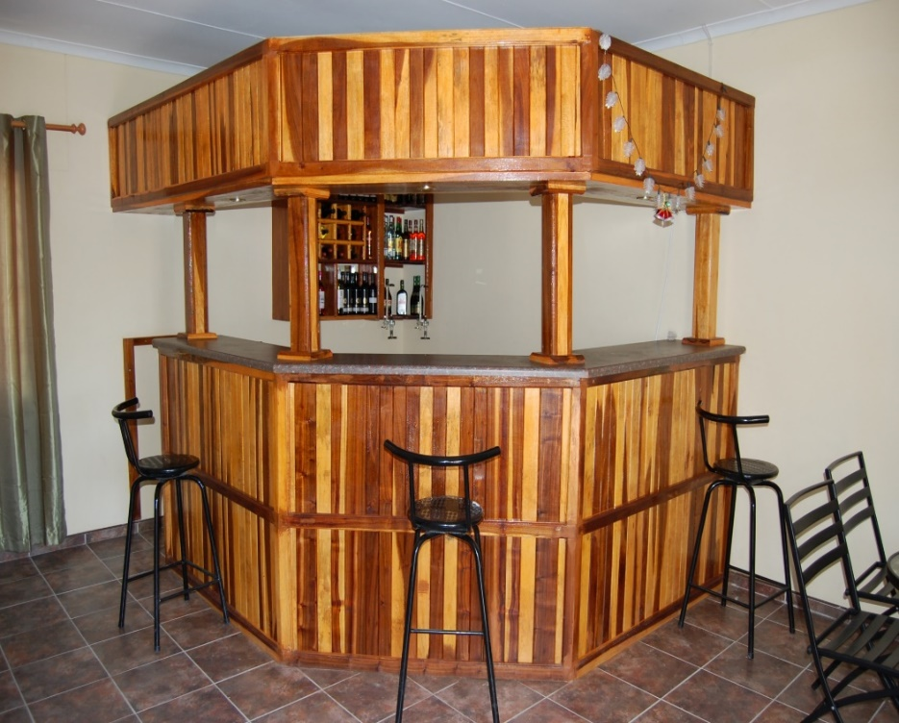
CHALLENGES
Compliance to the conditions and trading hours
Common understanding on the implementation of the Liquor Act from all stakeholders

Slide 16
CONCLUSION
In order to develop a sustainable industry base at all levels
  Enhancement and promotion of compliance to the Liquor Act, 1998 while at the same time preserve employment opportunities and income generating activities
Key stakeholders and industry players engagement on regular bases to devise strategies to develop a consultative monitoring & evaluation system that ensure the effective administration of the Act for the benefits of all.

Slide 17


